Slide 1
COT5615: Math for Intelligent Systems I
Anand Rangarajan
Lecture 38

Slide 2
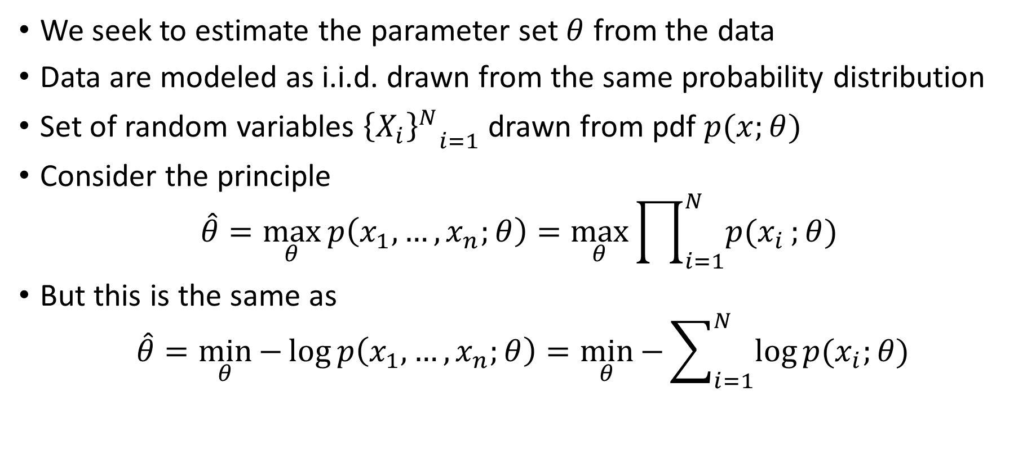
The Maximum Likelihood Principle
We seek to estimate the parameter set $θ$ from the data
Data are modeled as i.i.d. drawn from the same probability distribution
Set of random variables ${{\left\{X_{i}\right\}}^{N}}_{i=1}$ drawn from pdf $p(x;θ)$
Consider the principle
$$\hat{θ}=\max_{θ}{p\left(x_{1},…,x_{n};θ\right)}=\max_{θ}{\prod_{i=1}^{N}{p(x_{i}};θ) }$$
But this is the same as
$$\hat{θ}=\min_{θ}{−\log{p\left(x_{1},…,x_{n};θ\right)}}=\min_{θ}{−\sum_{i=1}^{N}{\log{p(x_{i};θ)}}}$$

Slide 3
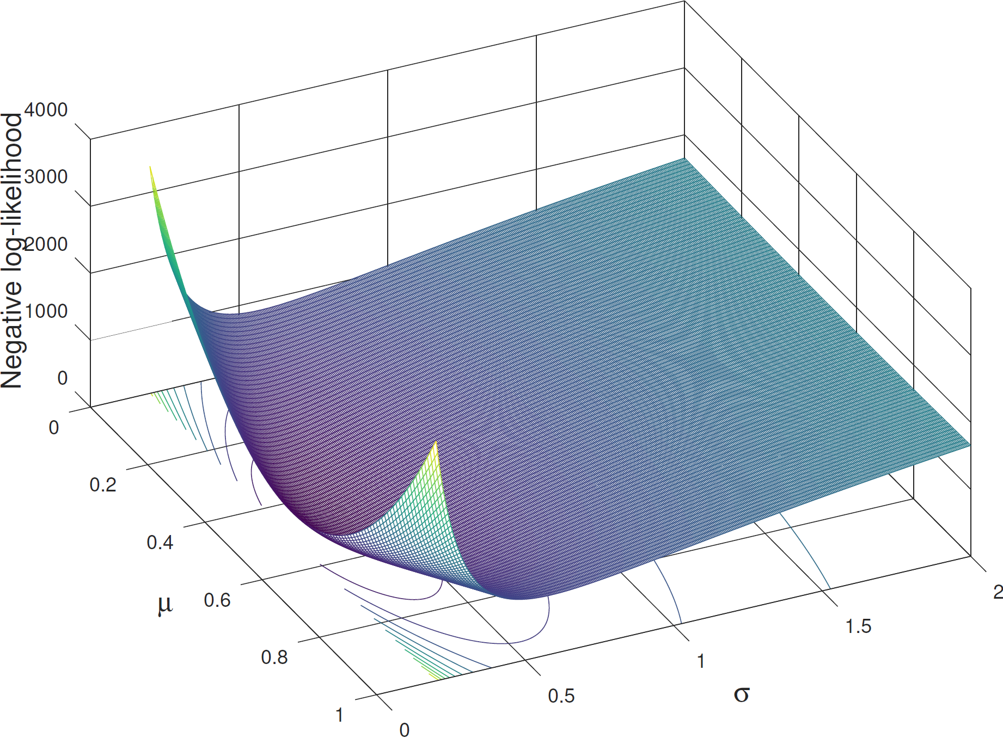
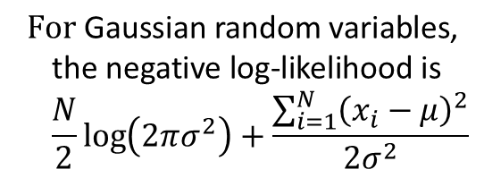
Application to Gaussian pdf
$$\text{F}\text{or} \text{Gaussian} \text{random} \text{variables}\text{,}$$
$$\text{the} \text{negative} \text{log}\text{−}\text{likelihood} \text{is}$$
$${\frac{N}{2}\log\left(2πσ^{2}\right)+\frac{\sum_{i=1}^{N}{{\left(x_{i}−μ\right)}^{2}}}{2σ^{2}}}$$

Slide 4
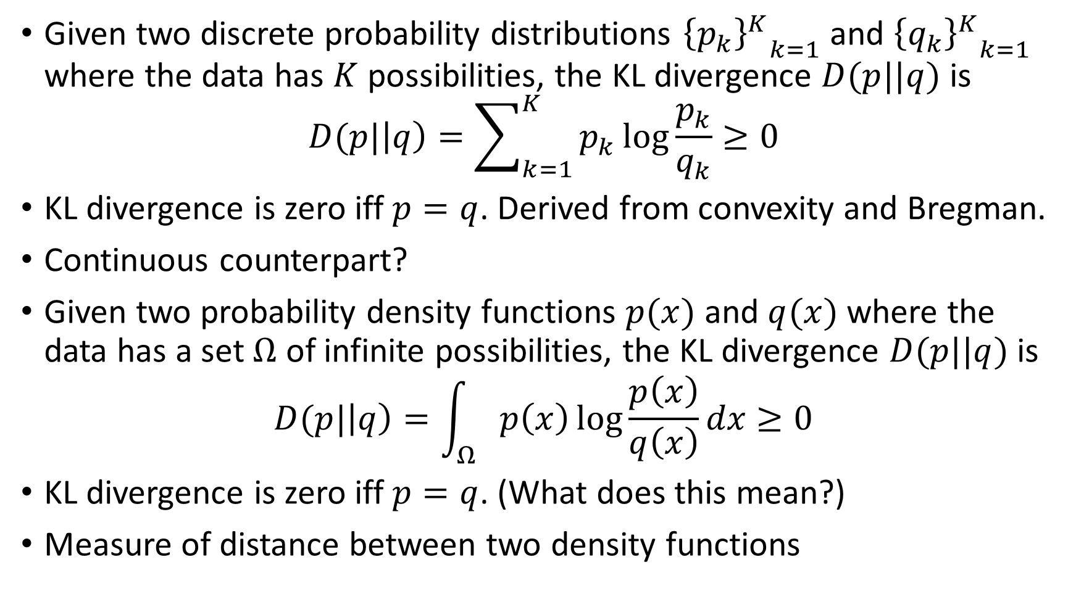
The Kullback-Leibler (KL) divergence
Given two discrete probability distributions ${{\left\{p_{k}\right\}}^{K}}_{k=1}$ and ${{\left\{q_{k}\right\}}^{K}}_{k=1}$ where the data has $K$ possibilities, the KL divergence $D(p||q)$ is
$$D(p|\left|q\right)=\sum_{k=1}^{K}{p_{k}\log{\frac{p_{k}}{q_{k}}}}≥0$$
KL divergence is zero iff $p=q$. Derived from convexity and Bregman.
Continuous counterpart?
Given two probability density functions $p(x)$ and $q(x)$ where the data has a set $Ω$ of infinite possibilities, the KL divergence $D(p||q)$ is
$$D(p|\left|q\right)=\int_{Ω}{p\left(x\right)\log{\frac{p\left(x\right)}{q\left(x\right)}}dx}≥0$$
KL divergence is zero iff $p=q$. (What does this mean?)
Measure of distance between two density functions

Slide 5
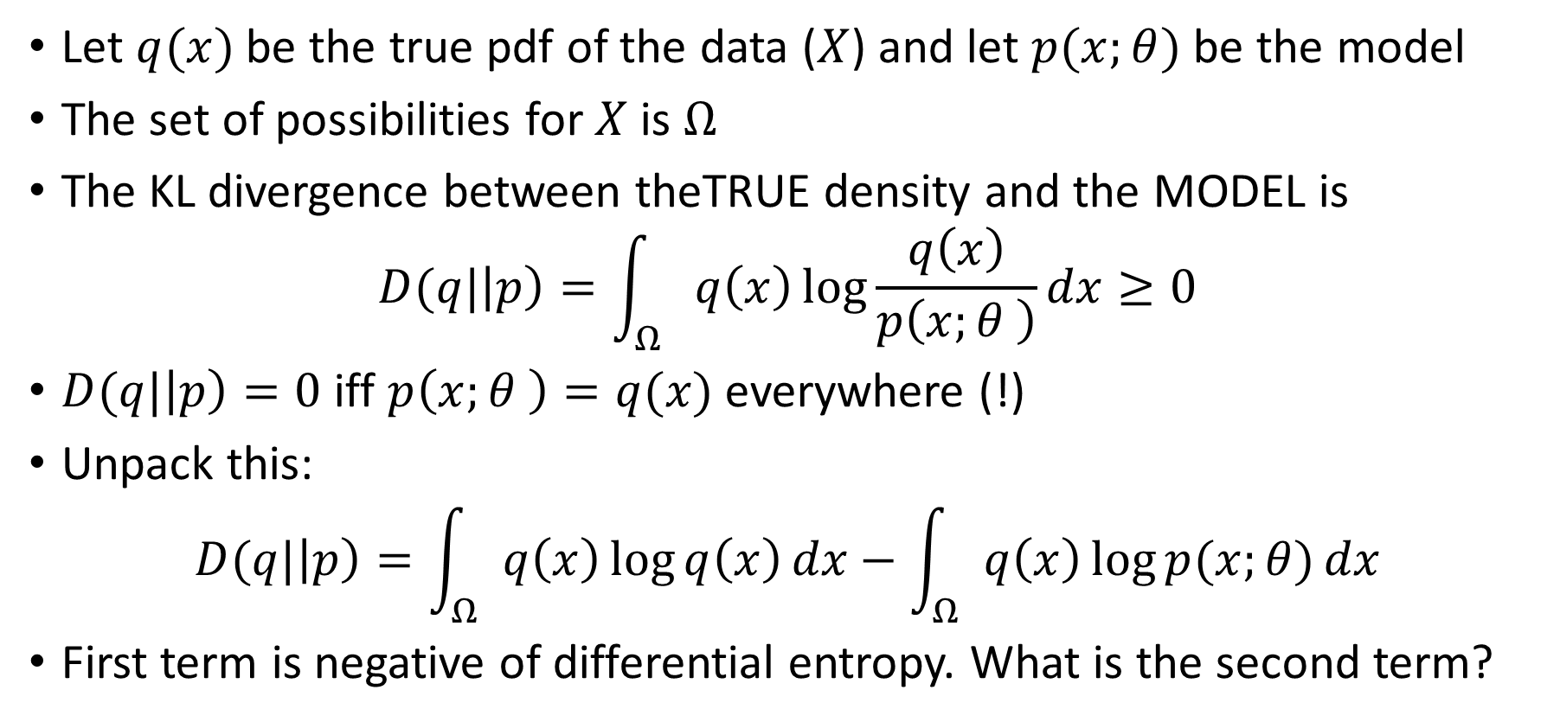
Divergence between True pdf and Model pdf
Let $q(x)$ be the true pdf of the data ($X$) and let $p(x;θ)$ be the model
The set of possibilities for $X$ is $Ω$
The KL divergence between theTRUE density and the MODEL is
$$D(q|\left|p\right)=\int_{Ω}{q\left(x\right)\log{\frac{q\left(x\right)}{p\left(x;θ \right)}}dx}≥0$$
$D(q|\left|p\right)=0$ iff $p\left(x;θ \right)=q(x)$ everywhere (!)
Unpack this:
$$D(q|\left|p\right)=\int_{Ω}{q\left(x\right)\log{q\left(x\right)}dx}−\int_{Ω}{q\left(x\right)\log{p(x;θ)}dx}$$
First term is negative of differential entropy. What is the second term?

Slide 6
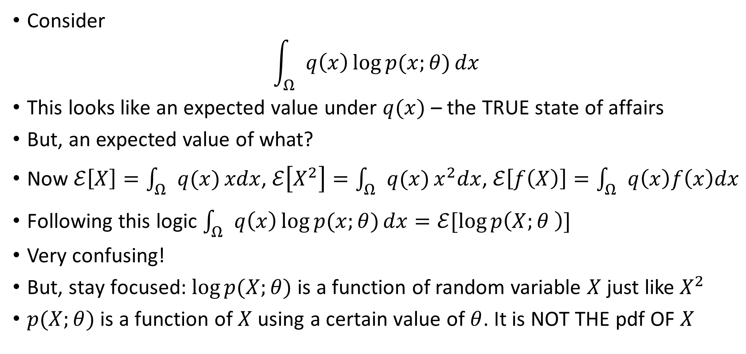
Divergence between the True and the Model
Consider
$$\int_{Ω}{q\left(x\right)\log{p(x;θ)}dx}$$
This looks like an expected value under $q(x)$ – the TRUE state of affairs
But, an expected value of what?
Now $ℰ\left[X\right]=\int_{Ω}{q(x)}xdx$, $ℰ\left[X^{2}\right]=\int_{Ω}{q(x)}x^{2}dx$, $ℰ\left[f\left(X\right)\right]=\int_{Ω}{q\left(x\right)f\left(x\right)dx}$
Following this logic $\int_{Ω}{q\left(x\right)\log{p(x;θ)}dx}=ℰ[\log{p\left(X;θ \right)}]$
Very confusing!
But, stay focused: $\log{p(X;θ)}$ is a function of random variable $X$ just like $X^{2}$
$p(X;θ)$ is a function of $X$ using a certain value of $θ$. It is NOT THE pdf OF $X$

Slide 7
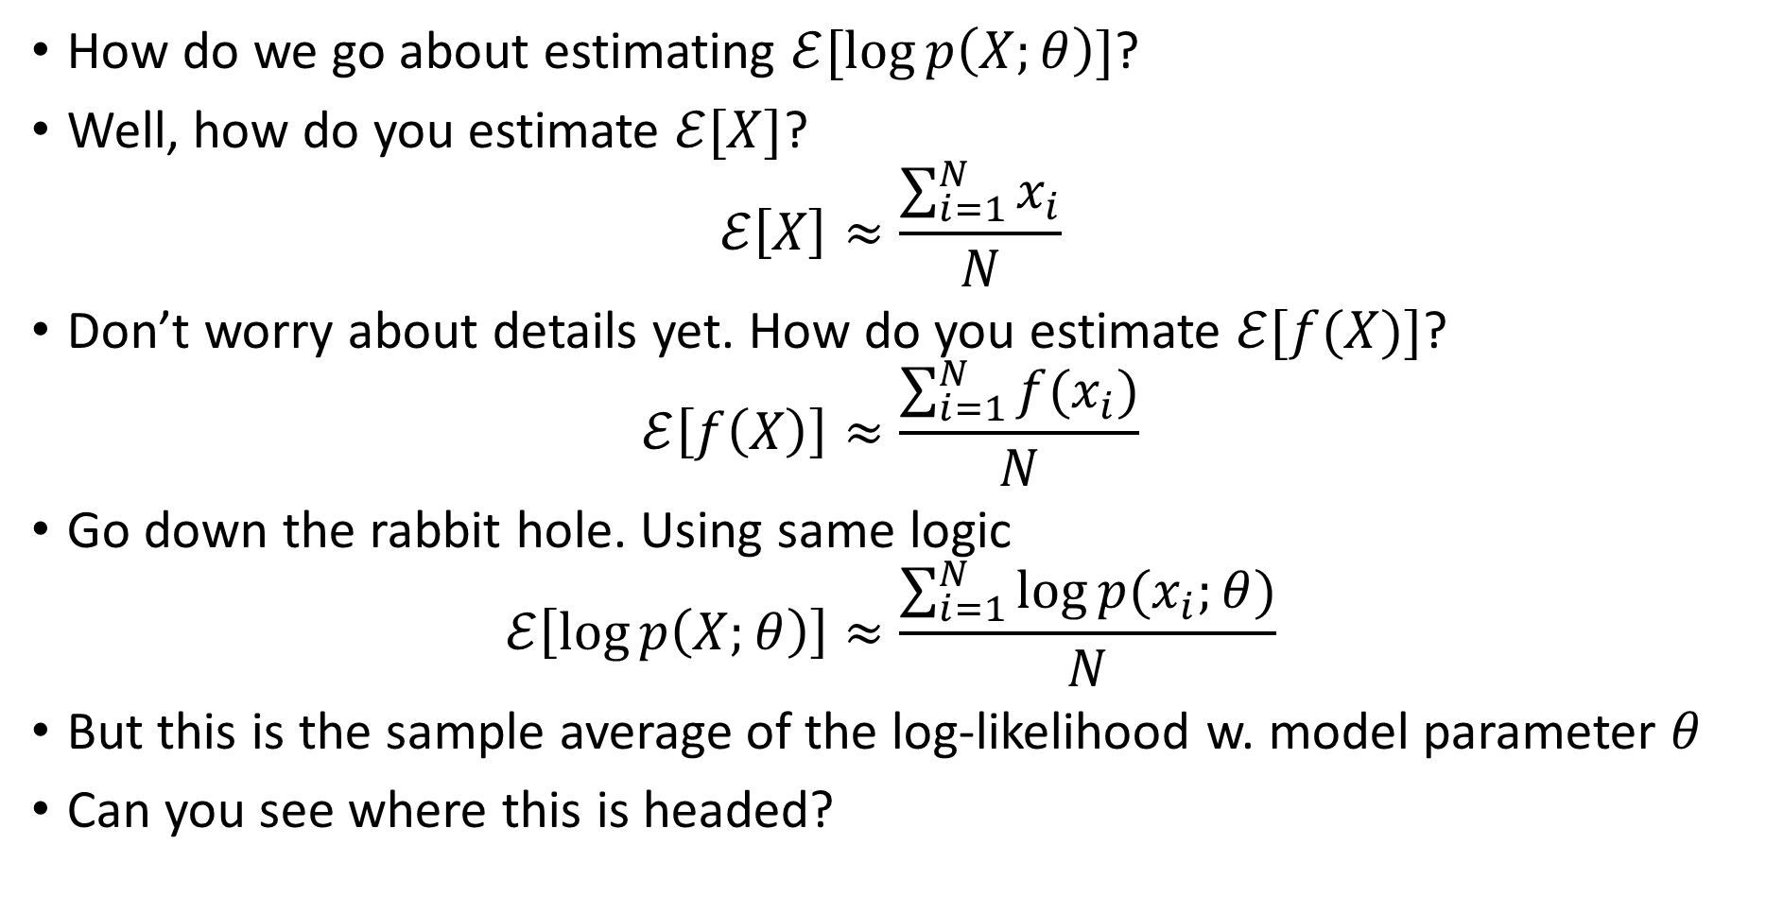

Estimating $ℰ[\log{p\left(X;θ\right)}]$
How do we go about estimating $ℰ[\log{p\left(X;θ\right)}]$?
Well, how do you estimate $ℰ[X]$?
$$ℰ\left[X\right]≈\frac{\sum_{i=1}^{N}{x_{i}}}{N}$$
Don’t worry about details yet. How do you estimate $ℰ[f(X)]$?
$$ℰ\left[f\left(X\right)\right]≈\frac{\sum_{i=1}^{N}{f(x_{i})}}{N}$$
Go down the rabbit hole. Using same logic
$$ℰ\left[\log{p\left(X;θ\right)}\right]≈\frac{\sum_{i=1}^{N}{\log{p(x_{i};θ)}}}{N}$$
But this is the sample average of the log-likelihood w. model parameter $θ$
Can you see where this is headed?

Slide 8
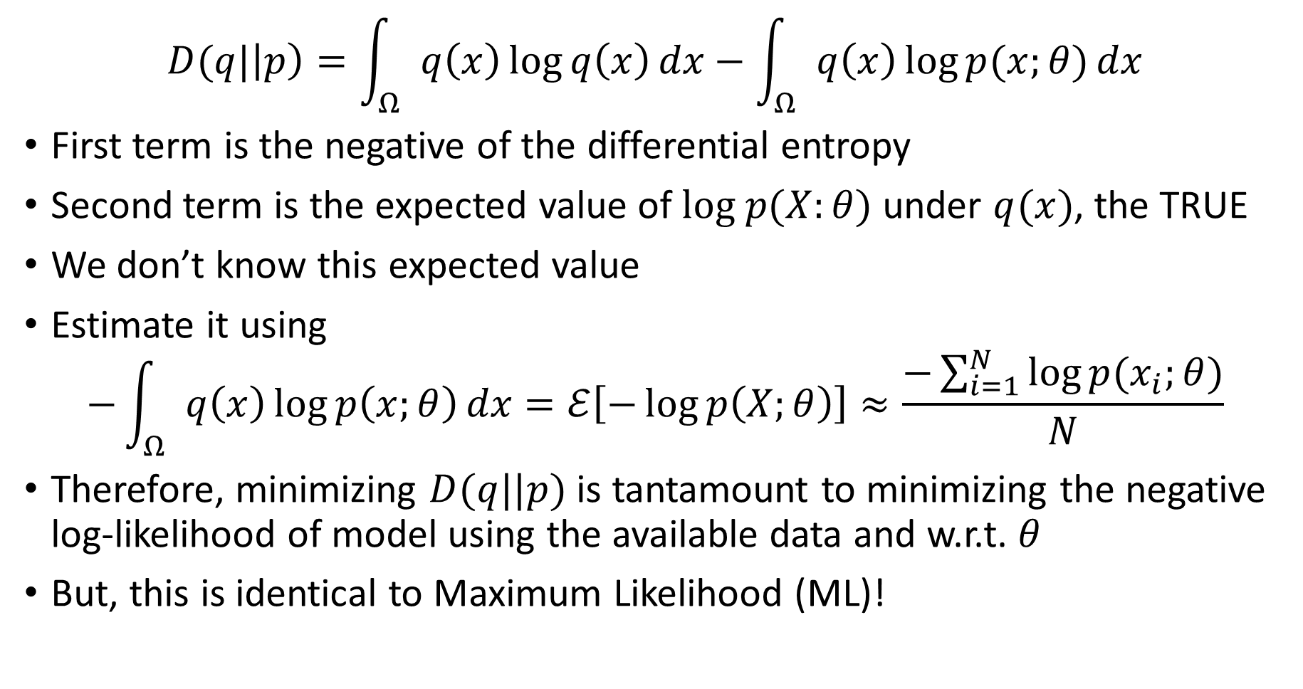
Divergence between the True and the Model
$$D(q|\left|p\right)=\int_{Ω}{q\left(x\right)\log{q\left(x\right)}dx}−\int_{Ω}{q\left(x\right)\log{p(x;θ)}dx}$$
First term is the negative of the differential entropy
Second term is the expected value of $log p(X:θ)$ under $q(x)$, the TRUE
We don’t know this expected value
Estimate it using
$$−\int_{Ω}{q\left(x\right)\log{p\left(x;θ\right)}dx}=ℰ\left[−\log{p\left(X;θ\right)}\right]≈\frac{−\sum_{i=1}^{N}{\log{p(x_{i};θ)}}}{N}$$
Therefore, minimizing $D(q||p)$ is tantamount to minimizing the negative log-likelihood of model using the available data and w.r.t. $θ$
But, this is identical to Maximum Likelihood (ML)!

Slide 9
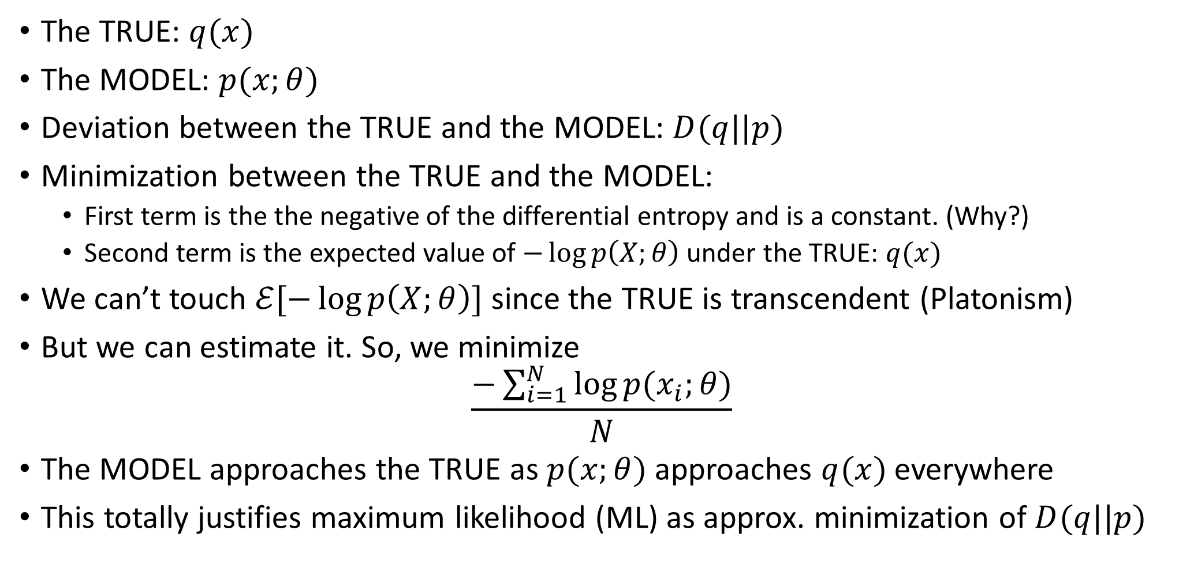
The Principle
The TRUE: $q(x)$
The MODEL: $p(x;θ)$
Deviation between the TRUE and the MODEL: $D(q||p)$
Minimization between the TRUE and the MODEL:
First term is the the negative of the differential entropy and is a constant. (Why?)
Second term is the expected value of $−\log{p\left(X;θ\right)}$ under the TRUE: $q(x)$
We can’t touch $ℰ[−\log{p\left(X;θ\right)}]$ since the TRUE is transcendent (Platonism)
But we can estimate it. So, we minimize
$$\frac{−\sum_{i=1}^{N}{\log{p(x_{i};θ)}}}{N}$$
The MODEL approaches the TRUE as $p(x;θ)$ approaches $q(x)$ everywhere
This totally justifies maximum likelihood (ML) as approx. minimization of $D(q||p)$

Slide 10
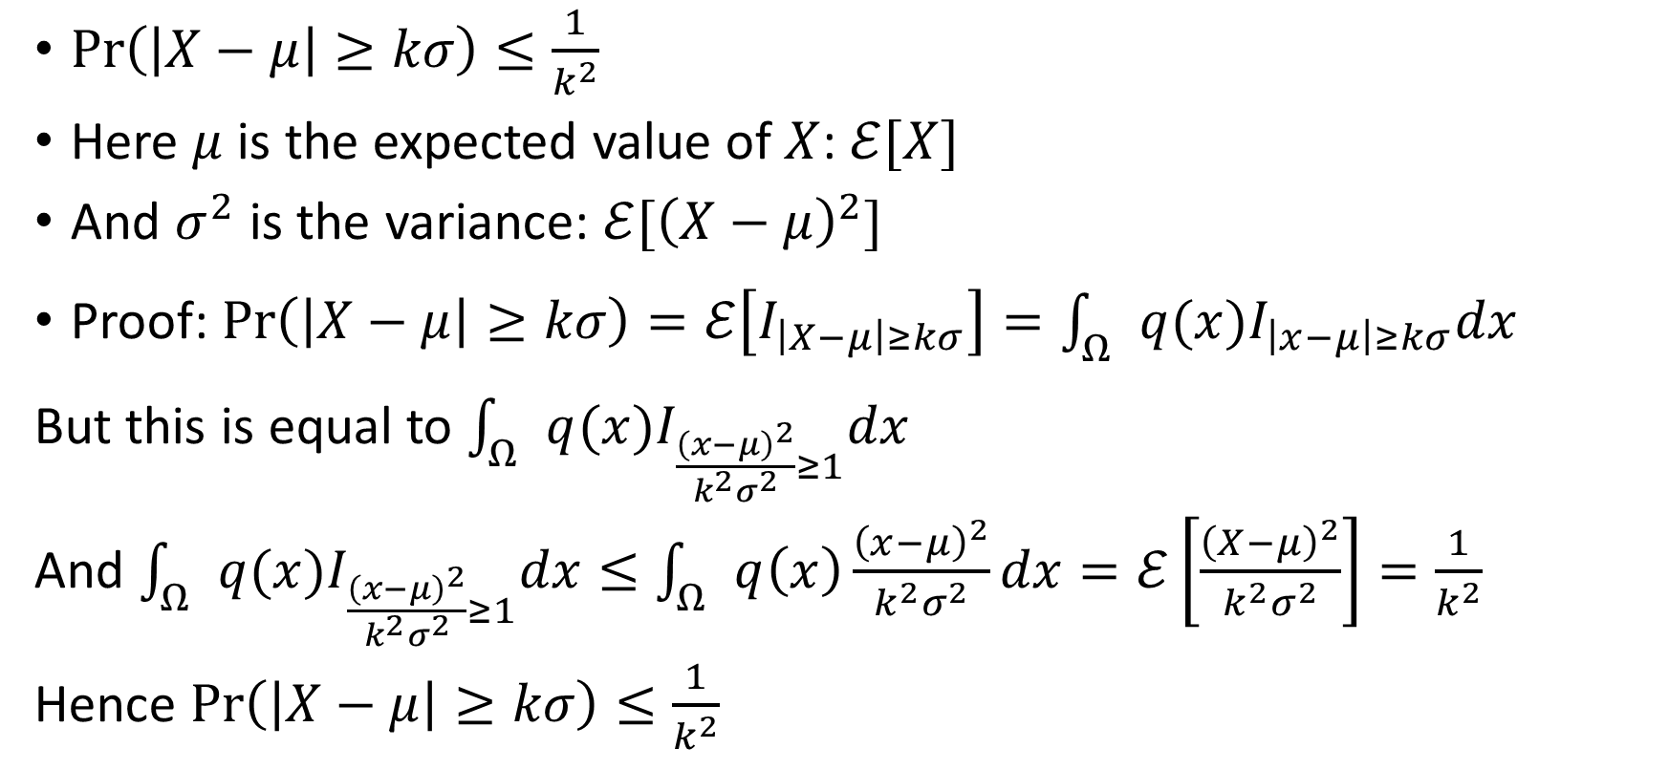
An Aside: Chebyshev’s Inequality
$\operatorname{Pr}\left(\left|X−μ\right|≥kσ\right)≤\frac{1}{k^{2}}$
Here $μ$ is the expected value of $X$: $ℰ[X]$
And $σ^{2}$ is the variance: $ℰ[{\left(X−μ\right)}^{2}]$
Proof: $\operatorname{Pr}\left(\left|X−μ\right|≥kσ\right)=ℰ\left[I_{\left|X−μ\right|≥kσ}\right]=\int_{Ω}{q(x)I_{\left|x−μ\right|≥kσ}dx}$
But this is equal to $\int_{Ω}{q(x)I_{\frac{{\left(x−μ\right)}^{2}}{k^{2}σ^{2}}≥1}dx}$
And $\int_{Ω}{q(x)I_{\frac{{\left(x−μ\right)}^{2}}{k^{2}σ^{2}}≥1}dx}≤\int_{Ω}{q\left(x\right)}\frac{{\left(x−μ\right)}^{2}}{k^{2}σ^{2}}dx=ℰ\left[\frac{{\left(X−μ\right)}^{2}}{k^{2}σ^{2}}\right]=\frac{1}{k^{2}}$
Hence $\operatorname{Pr}\left(\left|X−μ\right|≥kσ\right)≤\frac{1}{k^{2}}$

Slide 11
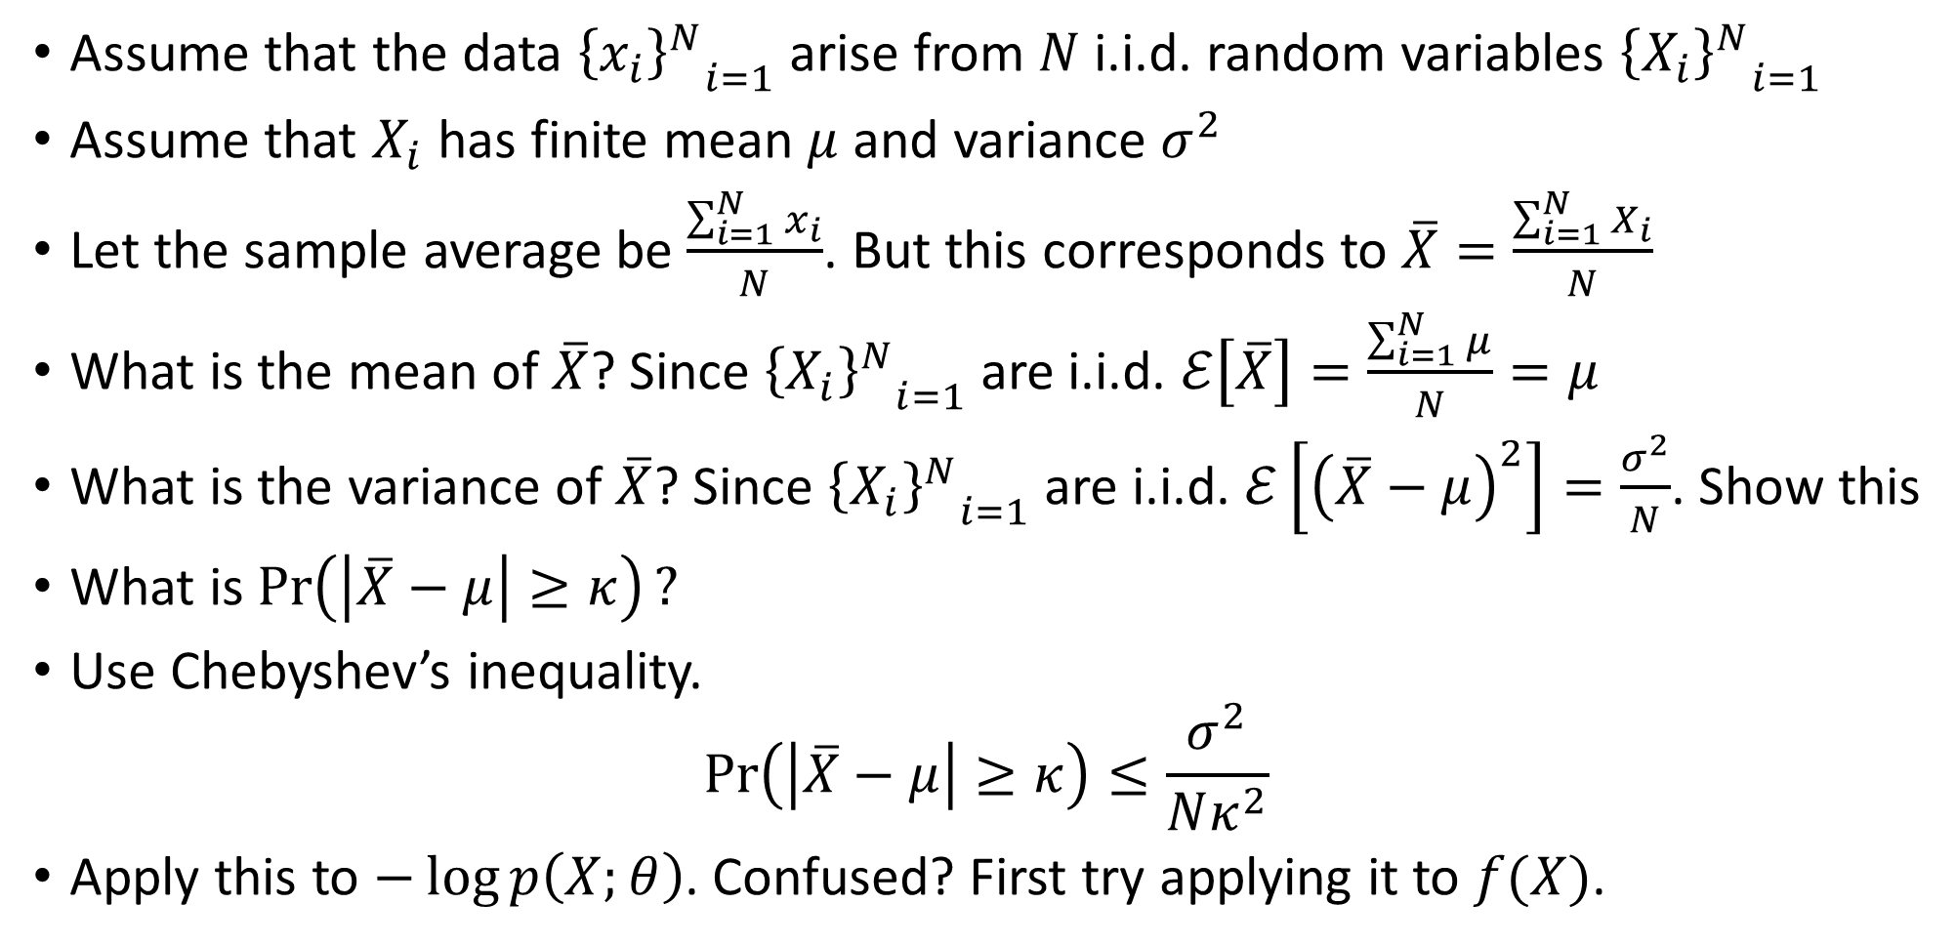
The Weak Law Of Large Numbers
Assume that the data ${{\left\{x_{i}\right\}}^{N}}_{i=1}$ arise from $N$ i.i.d. random variables ${{\left\{X_{i}\right\}}^{N}}_{i=1}$
Assume that $X_{i}$ has finite mean $μ$ and variance $σ^{2}$
Let the sample average be $\frac{\sum_{i=1}^{N}{x_{i}}}{N}$. But this corresponds to $\overline{X}=\frac{\sum_{i=1}^{N}{X_{i}}}{N}$
What is the mean of$\overline{X}$? Since ${{\left\{X_{i}\right\}}^{N}}_{i=1}$ are i.i.d. $ℰ\left[\overline{X}\right]=\frac{\sum_{i=1}^{N}{μ}}{N}=μ$
What is the variance of $\overline{X}$? Since ${{\left\{X_{i}\right\}}^{N}}_{i=1}$ are i.i.d. $ℰ\left[{\left(\overline{X}−μ\right)}^{2}\right]=\frac{σ^{2}}{N}$. Show this
What is $\operatorname{Pr}\left(\left|\overline{X}−μ\right|≥κ\right)?$
Use Chebyshev’s inequality.
$$\operatorname{Pr}\left(\left|\overline{X}−μ\right|≥κ\right)≤\frac{σ^{2}}{Nκ^{2}}$$
Apply this to $−\log{p\left(X;θ\right)}$. Confused? First try applying it to $f(X)$.

Slide 12
An Editorial
Can teach yourself relevant math using the process used this semester
Don’t rote learn anything
Start from what you want to know
Operate on your mind: Know what you don’t know
Anything you don’t understand, encapsulate it in a module
For each module, scour Internet and get the actual technical details
Stitch together the set of modules
…
Profit! (Worked for Wade Watts)

